Slide 1
PROJECT TITLE: PERSONALIZED AI SHOPPING COPILOT
CSE7101- Capstone Project
Review-1
Batch Number: Samsung_9
Under the Supervision of,
Dr. Nagaraja S.R.
Associate Professor -Selection Grade
School of Computer Science and Engineering
Presidency University
Roll Number | Student Name
20221CAI0002 | Hida Fathima P H
20221CSE0291 | Ruchitha A S
20221ECE0134 | Manasa B S
Name of the Program: B.Tech
Name of the HoD: Refer- Annexure-1
Name of the Program Project Coordinator: Refer- Annexure-1
Name of the School Project Coordinators: Dr. Sampath A K , Dr. Geetha A

Slide 2
Problem Statement Number: 4
Organization: School of Computer Science and Engineering
Category (Hardware / Software / Both) : Software
Problem Description:
Existing e-commerce recommendation engines lack the conversational and multimodal capabilities that modern customers expect. They are typically limited to keyword searches and cannot understand natural dialogue or visual inputs like images. This results in a rigid, impersonal shopping experience that fails to capture a user's real-time needs for personalized recommendations, comparisons, and product bundles.

Slide 3
Content
Problem Statement
Objectives
Background and Related work for title Selection
Analysis of Problem Statement
Innovation or Novel Contributions
Git-hub Link
Timeline of the Project
References

Slide 4
Problem Statement
Existing e-commerce recommendation systems are often impersonal and rigid, relying on historical data and predefined filters.
They lack the ability to engage in natural, human-like conversations, leading to a disconnected user experience.
Current systems are primarily text-based, failing to leverage visual input (images) from users, which limits the scope and accuracy of product discovery.

Slide 5
Objectives
To design a multimodal AI shopping assistant that understands both text and image-based queries for product recommendations.
To develop a conversational chatbot that provides an interactive, human-like dialogue for recommendations, comparisons, and bundle suggestions.
To create a system architecture that integrates advanced AI models (like CLIP and Sentence-BERT) for high-accuracy semantic and visual search.
To build a seamless and engaging user interface using a modern tech stack (React, FastAPI) that enhances user trust and satisfaction.

Slide 6
Background and Related work for title Selection
Conversational Commerce: Research shows that human-like traits in chatbots, such as empathy and social presence, significantly increase user trust and adoption (Sidlauskiene et al., 2023). This forms the basis for our conversational approach.
Recommendation Systems: Traditional e-commerce platforms (e.g., Amazon) heavily rely on collaborative and content-based filtering. While effective, these methods are not interactive and often feel like a "black box" to users.
Gaps in Existing Models:
Most current chatbots in e-commerce lack multimodal capabilities; they cannot process user-uploaded images for search.
There is a need for systems that can handle complex, conversational queries rather than simple keywords.
Few systems focus on explainable recommendations (i.e., telling the user why an item is recommended), which is a key factor in building trust.
Emerging AI Techniques: Recent advancements in models like CLIP (for aligning images and text) and LLMs (like LLaMA) make it feasible to build a system that addresses these gaps effectively.

Slide 7
Analysis of Problem Statement (contd...)
Input Analysis: The system must process two distinct types of input:
Textual Data: Natural language queries, conversational phrases, and specific product attributes.
Visual Data: User-uploaded images of clothing, accessories, or styles.
Core Technical Challenges:
Semantic Understanding: Accurately interpreting the meaning and intent behind conversational user queries.
Image-Text Alignment: Matching visual features from an image with textual descriptions of products in the database.
Dialogue Management: Maintaining context and coherence throughout a multi-turn conversation.
Real-time Performance: Ensuring the system responds quickly to user queries to maintain an engaging experience.
User Experience Goal: The primary goal is to shift the user experience from a simple "search-and-find" model to a more engaging "discover-and-delight" journey, guided by a helpful AI companion.

Slide 8
Analysis of Problem Statement
Technology Stack Components:
Frontend: React (for a dynamic and responsive user interface), Tailwind CSS (for rapid styling).
Backend: FastAPI or Firebase Functions (for a high-performance, scalable serverless backend).
Database: Firebase Firestore or a similar NoSQL database (for storing product metadata and image URLs).
AI Models & Libraries:
Image-Text Embeddings: CLIP (Contrastive Language–Image Pre-training).
Sentence Embeddings: Sentence-BERT / MiniLM (for understanding text queries).
Conversational AI: DialoGPT, LLaMA, or Google Gemini API (for managing dialogue).
Deployment: Vercel (for the frontend) and a cloud provider like Google Cloud or AWS (for the backend).

Slide 9
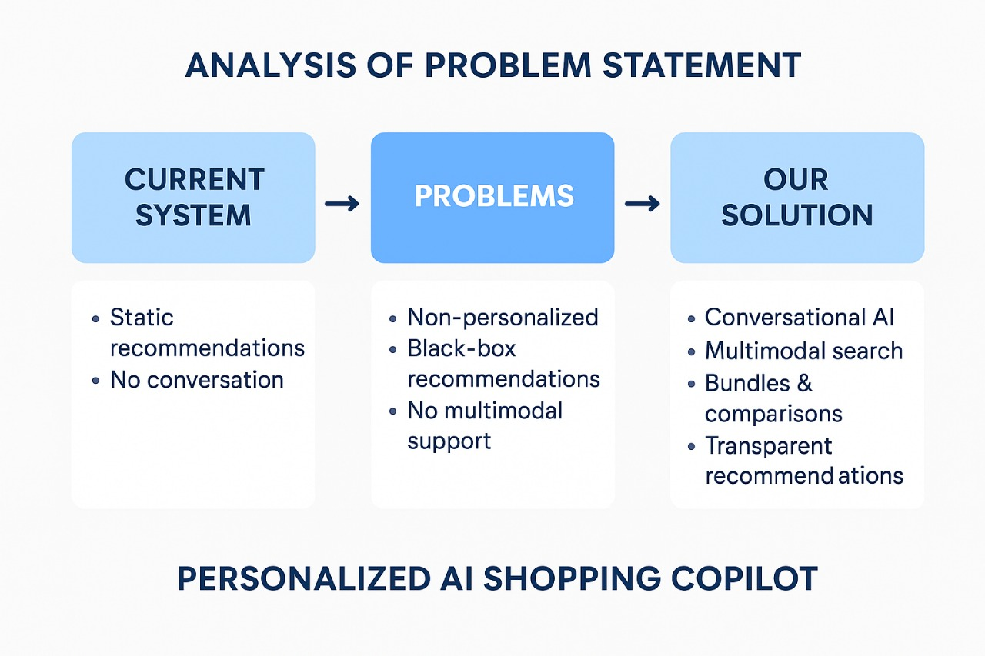
Analysis of Problem Statement (contd...)
Software and Hardware Requirements:
Software: Python 3.8+, Node.js, VS Code, Git.
Hardware: A standard development machine. For training/fine-tuning models, access to a GPU (like NVIDIA T4/V100) via Google Colab or a cloud service would be necessary.

Slide 10
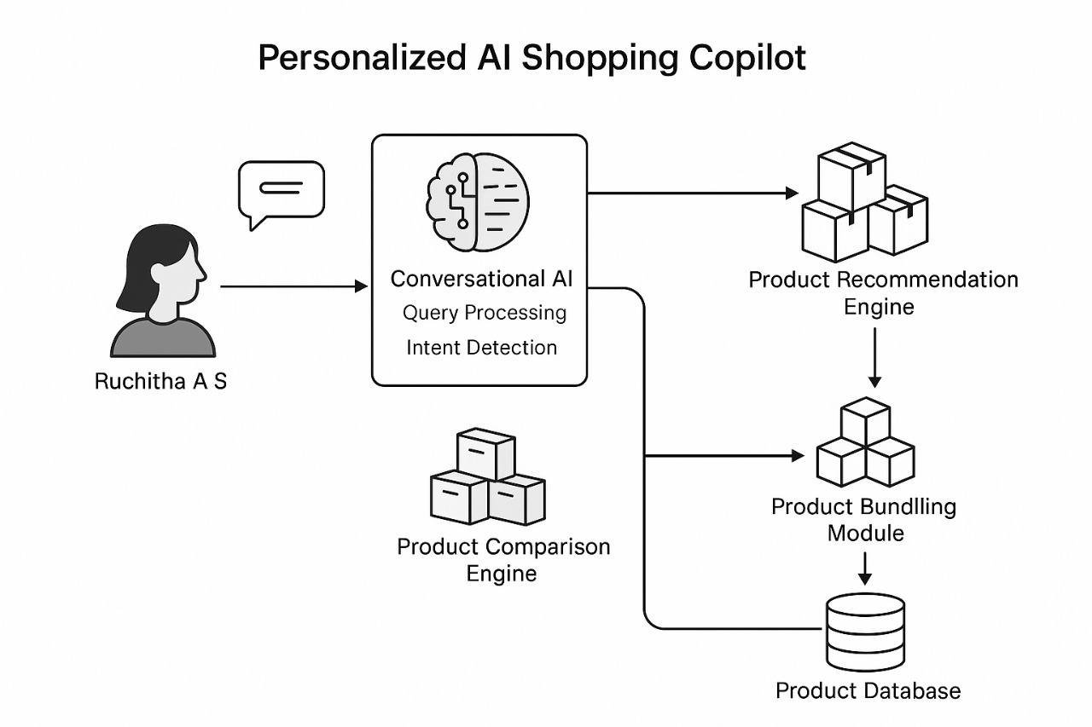

Slide 11
Innovation or Novel Contributions
True Multimodal Interaction:
Unlike systems with separate text and reverse-image search, our copilot will fuse these inputs.
Hybrid Recommendation Engine:
The system moves beyond traditional filtering by using deep learning embeddings (CLIP for vision, Sentence-BERT for text) to understand the meaning and style of products, leading to more accurate and nuanced recommendations.
Enhanced Conversational Ability:
By leveraging a large language model, the chatbot can handle complex dialogues, ask clarifying questions, and provide bundle suggestions, mimicking a real shopping assistant.
Focus on Trust and Transparency:
The design incorporates principles of explainable AI. The chatbot can articulate why a product is recommended, which builds user trust and confidence.

Slide 12
Github Link
The project is actively managed on GitHub to ensure version control and collaborative development.
The repository contains all source code, documentation, and project-related files.
Link: https://github.com/Hida-Fathima/Personalized_AI_Shopping_Copilot

Slide 13
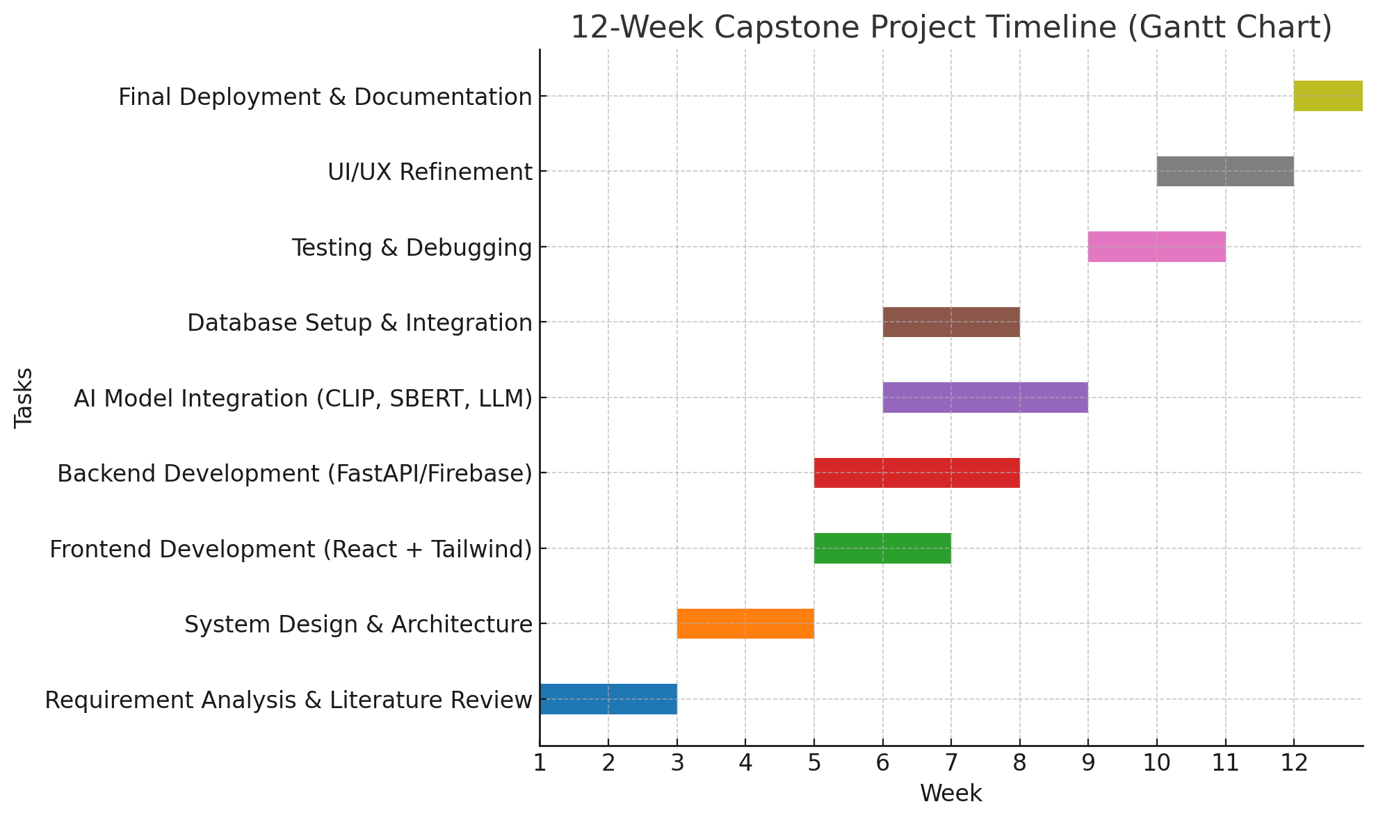
Timeline of the Project (Gantt Chart)

Slide 14
References (IEEE Paper format)
[1] Jindi Fu, Samar Mouakket, and Yuan Sun, “The role of chatbots’ human-like characteristics in online shopping,” Electronic Commerce Research and Applications, vol. 61, p. 101304, August 2023. doi:10.1016/j.elerap.2023.101304.
[2] Sidlauskiene, Justina, Yannick Joye, and Vilte Auruskeviciene, “AI-based chatbots in conversational commerce and their effects on product and price perceptions,” Electronic Markets, vol. 33, no. 1, May 2023. doi: 10.1007/s12525-023-00633-8. Available: ResearchGate.
[3] Badave P, Bhomaj B, Bindu B, Shivarkar R, Prof Dhavase N,“E-commerce website with recommendation system including chatbot and reverse image search”, International Journal for Research in Applied Science & Engineering Technology (IJRASET), vol. 10, no. 9, pp. 1663-80., Sep, 2022. Available: Link.
[4] M. Rahevar, Maharshi, and S. Darji, “The adoption of AI-driven chatbots into a recommendation for e-commerce systems to targeted customer in the selection of product,” International Journal of Management, Economics and Commerce, vol: 1, no. 2, 128-137, 2024. Available: Link.

Slide 15
References (Contd.)
[5] Valencia-Arias, Alejandro, Hernán Uribe-Bedoya, Juan David González-Ruiz, Gustavo Sánchez Santos, Edgard Chapoñan Ramírez, and Ezequiel Martínez Rojas. "Artificial intelligence and recommender systems in e-commerce. Trends and research agenda." Intelligent Systems with Applications 24, p.200435, Dec 2024. doi: 10.1016/j.iswa.2024.200435. DOI
[6] Priya , and Dr Nidhi Bhagat, “The impact of AI-powered chatbots on shopper experience in e-commerce,” International Journal of Creative Research Thoughts (IJCRT), vol. 13, April 2025. Available: Link
[7] Dwivedi, Rohit, Abhineet Anand, Prashant Johri, Arpit Banerji, and N.K Gaur. "Product based recommendation system on amazon data." Int J Creat Res Thoughts–IJCRT, June 2020. Available: Link
[8] Illescas-Manzano, María, Sergio Martínez-Puertas, Paulo Ribeiro Cardoso, and Cristina Segovia-López. "Use of Online Shop Chatbots: How Trust in Seller Moderates Brand Preference and Purchase Intention." In International Conference on Advanced Marketing Practice, pp. 151-171. Cham: Springer Nature Switzerland, Nov 2024. DOI

Slide 16


